Slide 1
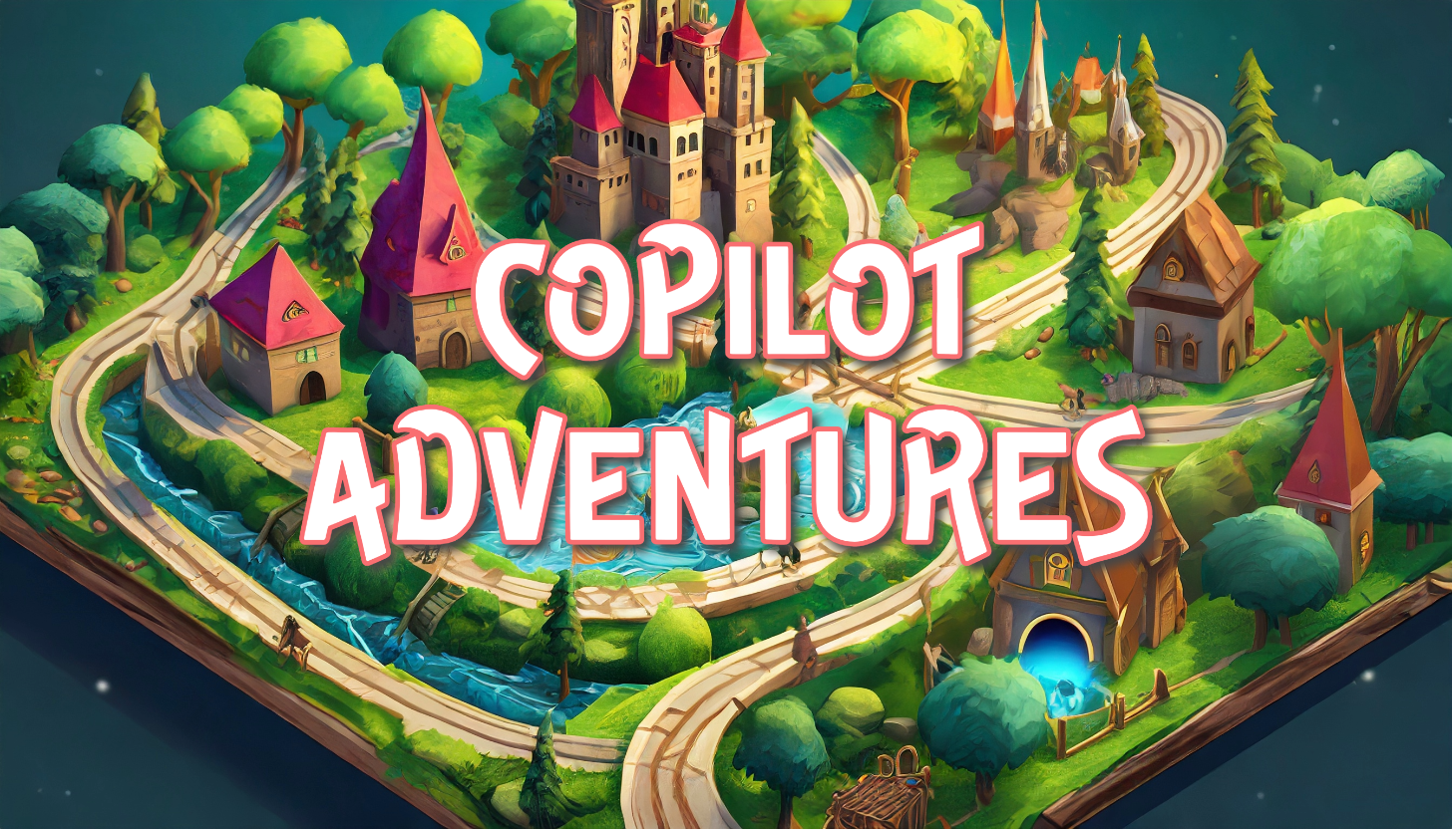

Slide 2
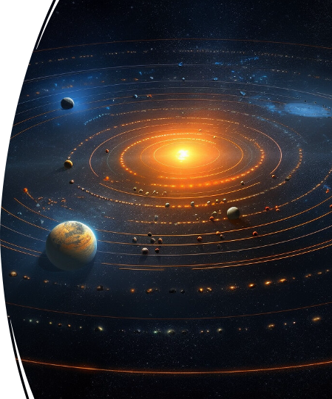
[Speaker Name]
Speaker-role

Slide 3
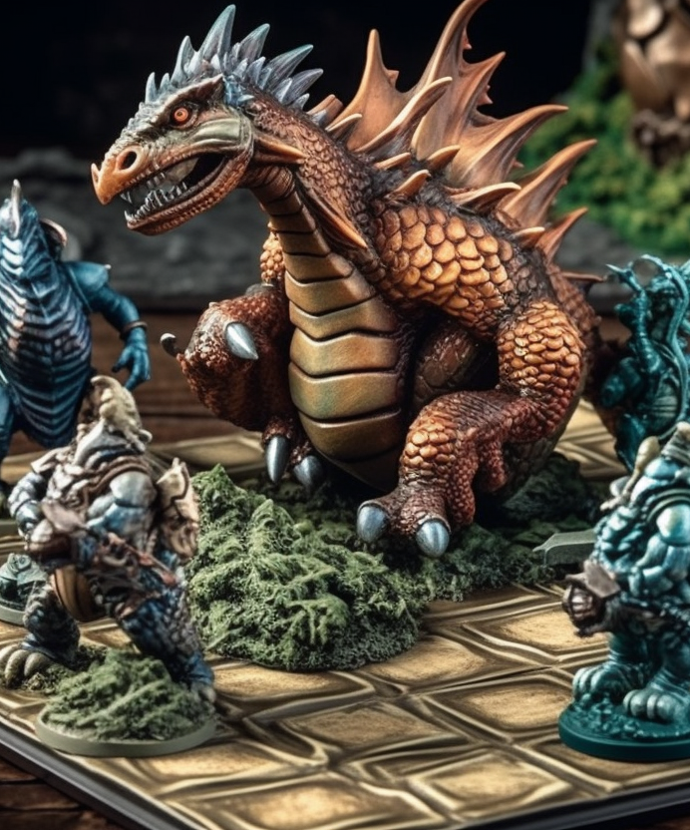
Agenda
What are Copilot Adventures?
Getting Started with GitHub Copilot
Warmup Adventure
Coding Adventures
Next Steps

Slide 4
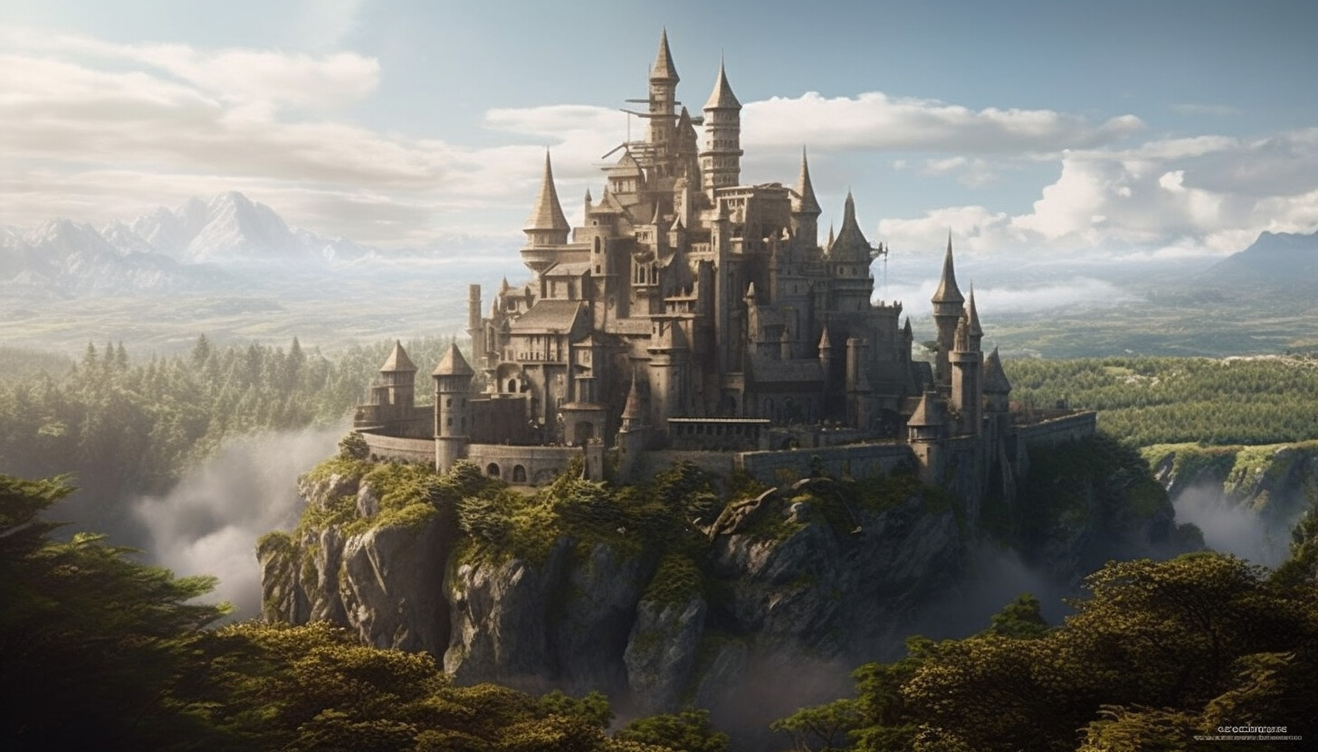
What are Copilot Adventures?
Coding challenges that people solve using GitHub Copilot
https://aka.ms/CopilotAdventures

Slide 5
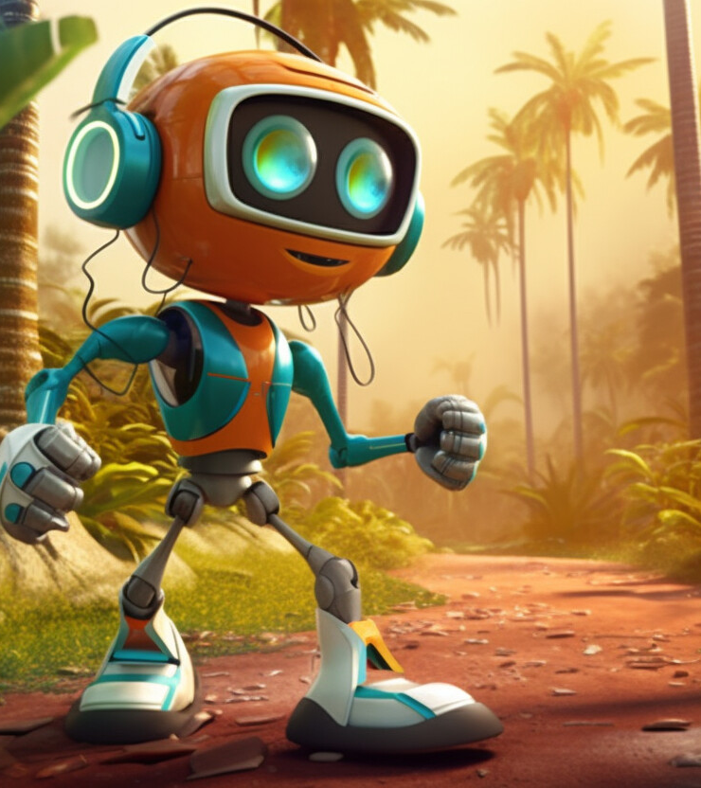
Demo: Warmup Adventure
The Chamber of Echoes – Learn how to get use GitHub Copilot to solve a simple adventure.
https://aka.ms/CopilotAdventures

Slide 6
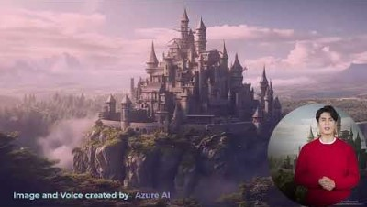

Slide 7
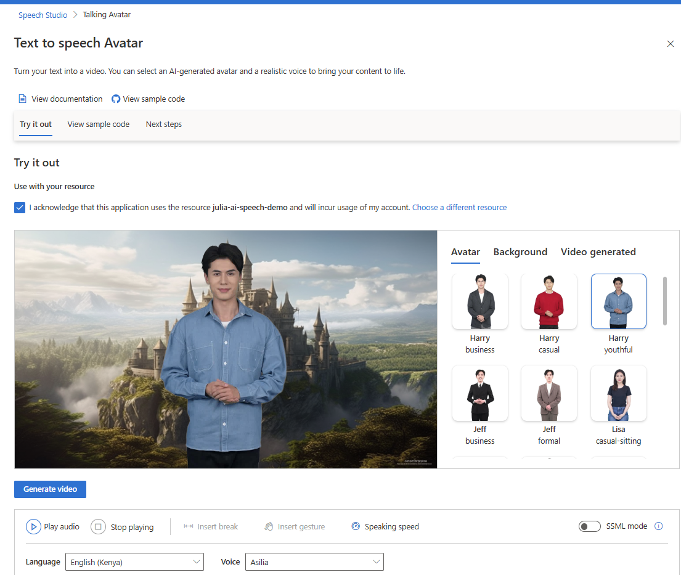
Fun Side Note
https://aka.ms/ai-avatar

Slide 8
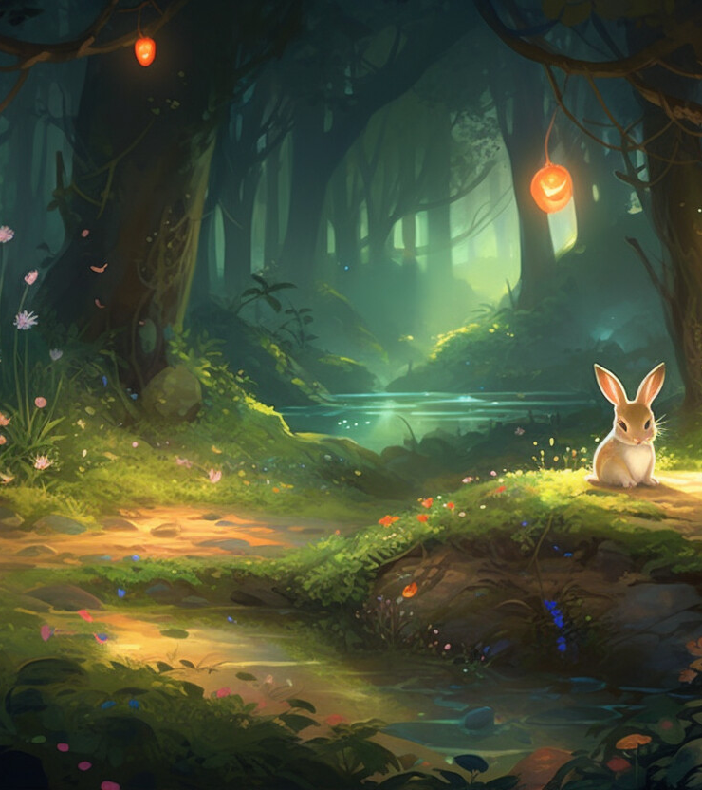
Coding Adventures
The Clockwork Town of Tempora
The Magical Forest of Algora
The Celestial Alignment of Lumoria
The Lengendary Duel of Stonevale
The Scrolls of Eldora
The Gridlock Arena of Mythos
https://aka.ms/CopilotAdventures

Slide 9
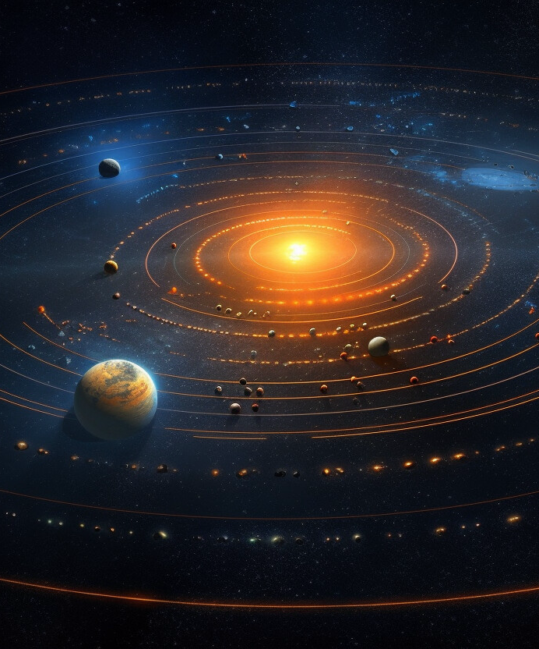
Next Steps
Fork and clone the GitHub Adventures repo (star it too!).
Complete the warmup adventure and learn the basics of using GitHub Copilot.
Complete another Copilot Adventure of your choice.

Slide 10

Submitting a New Adventure
Have an idea for a Copilot Adventure? Submit a PR!
https://aka.ms/CopilotAdventures

